Slide 1
Chapter 1
Fundamentals
By Tamal Dey
Assistant Professor, Dept. of MCA

Slide 2
Web Programming
Client-side
Technologies
Fundamentals
Server-side
Technologies
1. Perl
1. XHTML
2. CSS
2. CGI
3. JavaScript
3. Servlets & JSP
4. XML
4. PHP
5. XSLT
5. ASP.NET
6. Database
7. Ruby & Rails
8. AJAX

Slide 3
Content
A brief Introduction to the Internet
The World Wide Web
Web Browsers
Web Servers
Uniform Resource Locators
Multipurpose Internet Mail Extensions
The Hypertext Transfer Protocol
Security
The Web Programmer’s Toolbox
  Summary , Review Questions , Exercises

Slide 4
A Brief Intro to the Internet
Origins
  In 1960s the US Department Of Defense (DoD) interested in developing large scale computer network.
  The purpose of network were communication, program sharing, and remote computer access for researchers working on defense related contracts
  One fundamental requirement was that network should be robust (sturdy)enough so that network node should not lost due to sabotage, war etc.
The DoD’s introduced first such network named (ARPA) Advance Research Project Agency - 1968

Slide 5
Advance Research Project Agency
Origins
  ARPAnet - late 1960s and early 1970s
  Network reliability
  For ARPA-funded research organizations
  ARPAnet was simple text based communication through email. (DARPA-1972)
Problem scenario
  ARPA net was available only to laboratories and universities that conducted ARPA-funded research but it was not connected with educational institutions
  As a result various other network was developed like BITNET and CSNET

Slide 6

  BITNET (Because It’s Time Network) in New York
  CSNET (Computer Science Network) – Delware university etc.
BITnet, CSnet developed in late 1970s & early 1980s
  email and file transfer for other institutions
NSFnet - 1986 (National Science Foundation)
  Originally for non-DOD funded places
  Initially connected five universities supercomputers
  By 1990, it had replaced ARPAnet for non-military uses
  Soon became the network for all (by the early 1990s)
NSFnet eventually became known as the Internet

Slide 7
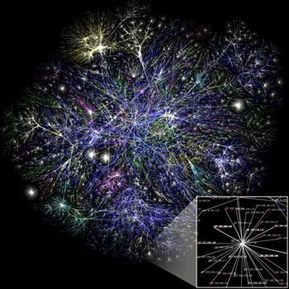
What the Internet is:
  A world-wide network of computer networks
  At the lowest level, since 1982, all connections use TCP/IP
  TCP/IP hides the differences among devices connected to the Internet

Slide 8
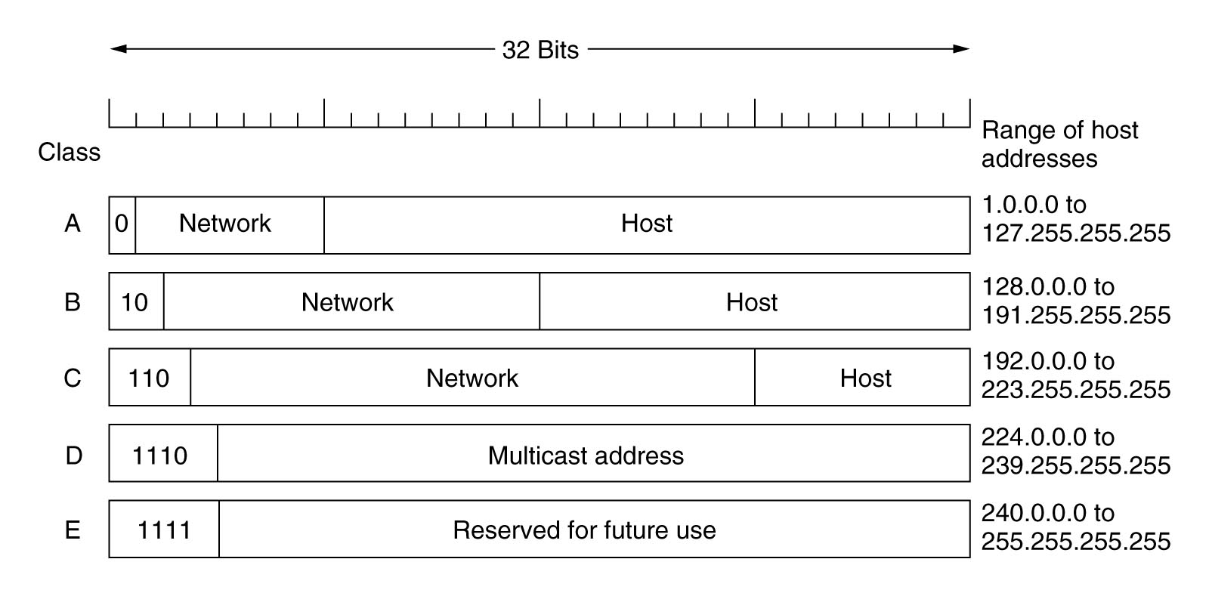
Internet Protocol (IP) Addresses 209.85.231.104
  Every node has a unique numeric address
  Form: 32-bit binary number or four 8 bit numbers with periods
  New standard, IPv6, has 32 bits to128 bits (1998)
  Organizations are assigned groups of IPs for their computers
  New standard found in ftp://ftp.isi.edu/in-notes/rfc2460.txt

Slide 9
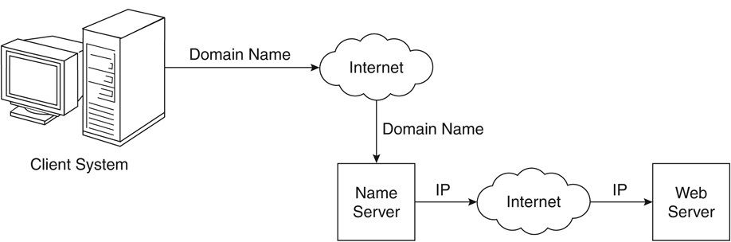
Domain name conversion

Slide 10
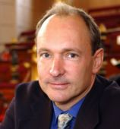

The World Wide Web
1989 – WWW concept
by Tim Berners-Lee
  European Organization for Nuclear Research
1990 – first browser/editor program
  It was called WorldWideWeb (no spaces) and was later renamed Nexus
Notes:
Tim Berners-Lee
Scientist at CERN (European centre for High Energy Physics – Geneva)
Hypertext Markup Language (HTML)

Slide 11
The World Wide Web
A possible solution to the rapid increase of different protocols being used on the Internet
Origins
  Tim Berners-Lee at European lab proposed the Web in 1989
  Purpose: to allow scientists to have access to many databases of scientific work through their own computers
  Document form: hypertext (text with embedded link)
    It consist of Pages, Documents, Resources
    We’ll call them documents
  Hypermedia – more than just text – images, sound, etc.
Web or Internet?
  The Web uses one of the protocols, http, that runs on the Internet--there are several others(telnet, mailto etc.)

Slide 12
Web Browsers
Mosaic –by NCSA (National Center for Supercomputer Application) by late 1993
  First to use a GUI, led to explosion of Web use
  Initially for X-Windows system, under UNIX, but was ported to other platforms by late 1993
Browsers are clients - always initiate, servers react (although sometimes servers require responses)
Most requests are for existing documents, using HyperText Transfer Protocol (HTTP)
But some requests are for program execution, with the output being returned as a document

Slide 13
Client and Server
Clients and Servers are programs that communicate with each other over the Internet
A Server runs continuously, waiting to be contacted by a Client
  Each Server provides certain services
  Services include providing web pages
A Client will send a message to a Server requesting the service provided by that server
  The client will usually provide some information, parameters, with the request

Slide 14
Web Servers
Web Servers are the programs that provides documents to requesting browsers
Provide responses to browser requests, either existing documents or dynamically built documents
Browser-server connection is now maintained through more than one request-response cycle
All communications between browsers and servers use Hypertext Transfer Protocol (HTTP)
Web servers run as background processes in the operating system
Some web servers are Apache, IIS, SunONE etc.

Slide 15
Web Server Operation
Web servers have two main directories:
  1. Document root (servable documents)
  2. Server root (server system software)
Document root is accessed indirectly by clients
Its actual location is set by the server configuration file
All current Web servers came from either
    The original from CERN (European Organization for Nuclear Research)
    The second one, from NCSA (National Center for Supercomputing Applications)
Requests are mapped to the actual location

Slide 16
`
Proxy servers
Web servers now support other Internet protocols
Apache (open source, fast, reliable)
  Directives (operation control):
    ServerName
    ServerRoot
    ServerAdmin,
    DocumentRoot
    Alias
    Redirect
    DirectoryIndex
    UserDir
IIS - Operation is maintained through a program with a GUI interface

Slide 17
URLs
Uniform Resource Locators
  Used to identify different resources
General form:
  scheme: object-address
The scheme is often a communications protocol, such as http, gopher, file, mailto, news, telnet or ftp
For the http protocol, the object-address is:
// fully qualified domain name/doc path
For the file protocol, only the doc path is needed
Host name may include a port number, as in
zeppo:80 (80 is the default)

Slide 18
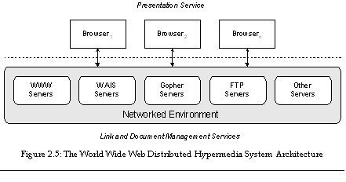

Slide 19
URLs cannot include spaces or any of a collection of other special characters (semicolons, colons, ...) it use %20 for space
The doc path may be abbreviated as a partial path
The rest is furnished by the server configuration
If the doc path ends with a slash, it means it is a directory
Details can be found at
  http://www.w3.org/Addressing/URL/URL_Overview.html

Slide 20
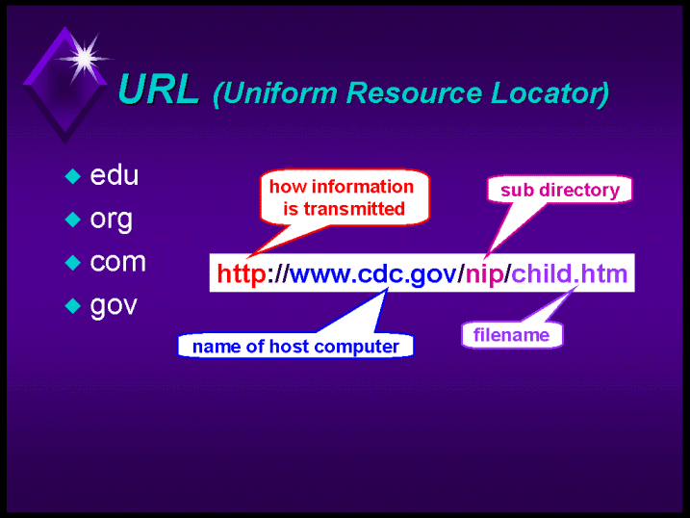

Slide 21
Multipurpose Internet Mail Extensions (MIME)
Originally developed for email
Used to specify to the browser the form of a file returned by the server (attached by the server to the beginning of the document)
Type specifications
  Form: type/subtype
Examples: text/plain, text/html, image/gif, image/jpeg
Server gets type from the requested file name’s suffix (.html implies text/html) or (unformatted text by text/plain)
Browser gets the type explicitly from the server. Otherwise browser is unable to render it

Slide 22
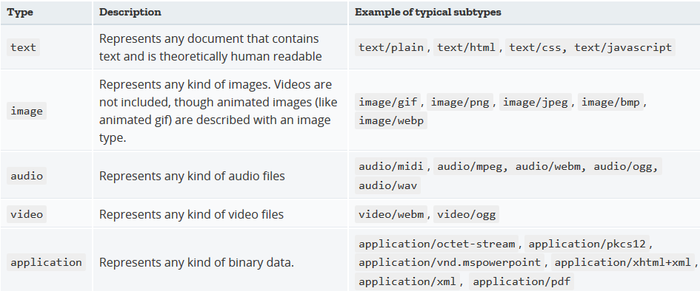
File Types
Browsers often use the MIME-type to determine what default action to do when a resource is fetched.

Slide 23
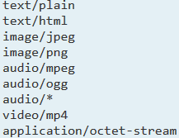
Experimental types
document type includes both type and subtype
Experimental types
  Subtype begins with x-
  e.g., video/x-msvideo
Experimental types require the server to send a helper application or plug-ins so the browser can deal with the file

Slide 24
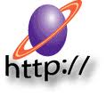
The Hypertext Transfer Protocol(http)
The protocol used by All Web communications
  Current Version : HTTP 1.1
  HTTP is formally defined as RFC 2616, approved in 1999
  Request for Comments (RFC) is available at
    World Wide Web Consortium (W3C)
  http://www.w3.org gives brief introduction
HTTP has two phases
  Request Phase
  Response Phase
Each http communication between browser and Web Server consist two part
  a header (Contains information about communication)
  a body (Contains data of communication)

Slide 25
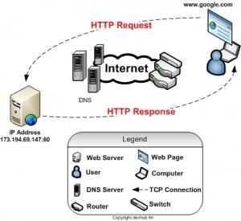

Slide 26
Request Phase
Form:
  HTTP method Domain part of URL HTTP version.
  Header fields (General/ Request/ Response/Entity)
  blank line
  Message body
An example of the first line of a request:
  GET/cs.uccp.edu/degrees.html HTTP/1.1
Most commonly used methods:
  GET - Fetch a document
  POST - Execute the document, using the data in body
  HEAD - Fetch just the header of the document
  PUT - Store a new document on the server
  DELETE - Remove a document from the server

Slide 27
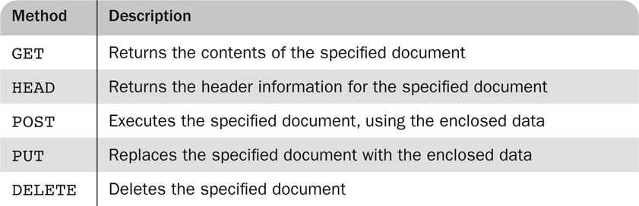
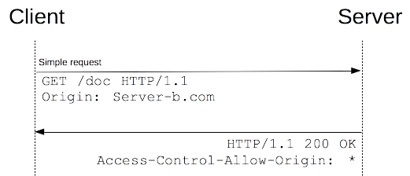
HTTP Request Methods

Slide 28
Four categories of header fields:
  General: For general information such as date
  Request: Included in request header
  Response: For response header
  Entity: used in both request and response header
Common request fields: MIME formats more than one
  Accept: text/plain
  Accept: text/html
  Accept: img/gif
  Accept: text/* (wildcard character)

Slide 29
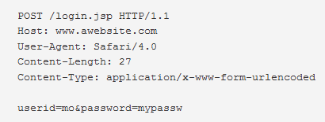
Example
GET, HEAD, DELETE don’t have bodies, in this case blank line signals notify end of request
Can communicate with HTTP without a browser in command line
  > telnet blanca.uccs.edu http
    GET /respond.html HTTP/1.1
    Host: blanca.uccs.edu

Slide 30
Response Phase
Form:
  Status line
  Response header fields
  blank line
  Response body
Status line format:
  HTTP version status code textual -explanation
  Example: HTTP/1.1 200 OK
Common status code:
  404: Not found
  200: request handled without error
  500: Server encountered a problem and was not able to fulfill the request

Slide 31
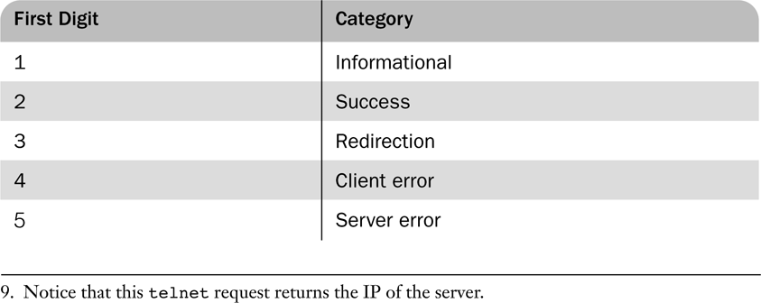
First Digits of HTTP Status Codes
Status code is a three-digit number; first digit specifies the general status
302-Moved Temporarily, The request resides temporarily at a different URI.
400- Bad Request. The server couldn't understand the request due to malformed syntax.
401-Unauthorized.The request requires authentication and/or authorization.
403-Forbidden.The server understood the request but for some reason is refusing to fulfill it.
404-Not Found, The server has not found anything matching the request URI.

Slide 32
The header field, Content-type, is required
An example of a complete response header:
  HTTP/1.1 200 OK
  Date: Tues, 18 May 2004 16:45:13 GMT
  Server: Apache (Red-Hat/Linux)
  Last-modified: Tues, 18 May 2004 16:38:38 GMT
  Etag: "841fb-4b-3d1a0179"
  Accept-ranges: bytes
  Content-length: 364
  Connection: close
  Content-type: text/html, charset =ISO-8859-1
Both request headers and response headers must be followed by a blank line

Slide 33

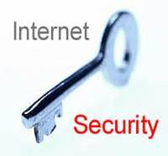
Security

Slide 34
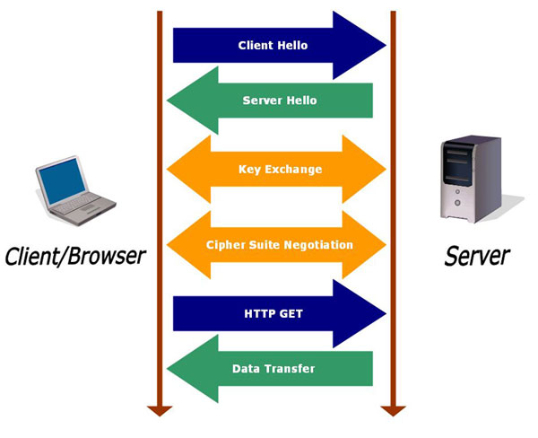

Slide 35
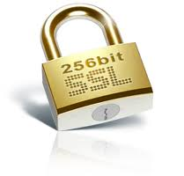
Security
Privacy: Credit card number and other details must not be stolen from server
Integrity: credit card details must not be modified in on its way to company’s server
Authentication: purchaser and seller must know their identity
Non repudiation (Rejecting) – legally prove that message was actually sent and received
Public /Private Key encryption- 1976

Slide 36
RSA (1997-MIT) is the most widely used public-key algorithm
Another security problem: destruction of data on computers connected to the Internet
Viruses and worms
Yet another common security problem:
Denial-of-Service (DoS)
  Zombie computers
  ILOVEYOU virus
  CodeRed virus

Slide 37
Sl. | Question Bank | Marks
1. | Define Internet. Explain IP address and DNS conversion with example and neat diagram. | 2+3+5
2. | Explain in detail about Web Browser and Web Server with example. | 5+5
3. | Give information about available Web Browser with explanation | 4
4. | Explain in detail (request + response) about HTTP Protocol. | 10
5. | What is MIME? Explain in brief | 5
6. | Explain the evolution journey of NSFnet . | 6
7. | List and explain web programmers toolbox. | 10
8. | What is www? Purpose and using internet. | 1+4
9. | Explain the concern about security issues while browsing with example for each. | 5
10. | Describe virus, malware, spam with an example for each. Differentiate each one with effect in system. | 6
11 | Explain url format with syntax and example | 4
12. | Request and response header format with example. | 6

Slide 38
Web Programmer’s Toolbox
Document languages and programming languages that are the building blocks of the web and web programming
  XHTML : A markup language
  Plug-ins
  Filters
  XML: A meta markup language
  Javascript
  Java, Perl, Ruby: Programming languages
  PHP
  Ajax: A programming technology that use JavaScript & XML

Slide 39
Web program and script are divided into two categories
Client Side
  XHTML, XML
Server Side
  Perl, PHP and Ruby
JavaScript is most often client side language, although it can be used for both
Java can be used for both

Slide 40
XHTML
To describe the general form and layout of documents
An XHTML document is a mix of content and controls
Controls are tags and their attributes
  Tags often delimit content and specify something about how the content should be arranged in the document
  Attributes provide additional information about the content of a tag
Element
  <p>………</p>
Attribute
  <font face=“courier new” size=6 align=“center>…….</font>

Slide 41
Tools for creating XHTML documents
  XHTML editors - make document creation easier
  Shortcuts to typing tag names, spell-checker, syntax checker, color code for easy to read and edit
    WYSIWYG (Pronounce as wizzy-wiz): XHTML editors
      Microsoft front page
      Dreamweaver
      Adobe PageMill
  Need not know XHTML to create XHTML documents

Slide 42
Plug-ins
For creating XHTML we can use this converter
Plug-ins are integrated into tools like word processors, effectively converting them to WYSIWYG
Plug-ins add new toolbar , buttons and menu element that provide convenient way to insert XHTML into document being edited or created
It also make available of the tools that are inherent to word processor during XHTML document creation, such as spell checker, and thesaurus

Slide 43
Filters
Convert documents in other formats to XHTML
  Like Microsoft word to XHTML
Filters are not part of editor or word processor, this is an advantage because they are platform independent

Slide 44
Plug-ins and Filters:
Advantages and Disadvantages
Advantages of both filters and plug-ins:
  Existing documents produced with other tools can be converted to XHTML documents
  Using a tool you already know how to produce XHTML code
    E.g. table creation
Disadvantages of both filters and plug-ins:
  XHTML output of both is not perfect - must be fine tuned
  XHTML may be non-standard
  You have two versions of the document, which are difficult to synchronize

Slide 45
XML
A meta-markup language
A meta-index is an index of indices
A simpler version of SGML (Standard Generalized Markup Language)
Used to create a new markup language for a particular purpose or area
Creates own user-defined tags which are design for a specific area, they can be meaningful
No presentation details
A simple and universal way of representing data of any textual kind

Slide 46
JavaScript
A client-side HTML-embedded scripting language
Only related to Java through syntax
Dynamically create and modify document and it is not object-oriented
Provides a way to access elements of HTML documents and dynamically change them
Validate form data and create dynamic XHTML document

Slide 47
Java
General purpose object-oriented programming language
Based on C++, but simpler and safer
Our focus is on applets, servlets, and JSP
Java has computation capability which is used to calculate some data in XHTML document

Slide 48
Perl
Provides server-side computation for HTML documents, through CGI
Perl is good for CGI programming because:
  Direct access to operating systems functions
  Powerful character string pattern-matching operations
  Access to database systems
  Perl is highly platform independent, and has been ported to all common platforms
  Perl is dominant for CGI programming business

Slide 49
PHP
A server-side scripting language
An alternative to CGI
Similar to JavaScript dynamic behavior for strings and arrays
PHP preprocess the XHTML requested output
The browser never sees PHP code
Used in database management system for web
Great for form processing and database access through the Web

Slide 50
Ruby
Ruby is an pure object-oriented interpretive script language released in 1996
Every data value is an object and all operations are via method calls
All classes either predefined or user defined can be sub classed
Dynamically methods can be added
Syntax of ruby is related to ada
No need to declare variables because dynamic typing is used

Slide 51
Rails
Rails is a development framework in web based application which access database.
Rails is based on MVC architecture
Rails are used with Ajax for developing
It produce visual effect
Rails are written is ruby

Slide 52
AJAX
Asynchronous JavaScript + XML
No new technologies or languages
Much faster for Web applications that have extensive user/server interactions
Uses asynchronous requests to the server
Requests and receives small parts of documents, resulting in much faster responses

Slide 53
Java Web Software
Servlets – server-side Java classes
JavaServer Pages (JSP) – a Java-based approach to server-side scripting
JavaServer Faces – adds an event-driven interface model on JSP

Slide 54
ASP.NET
Does what JSP and JSF do, but in the .NET environment
Allows.NET languages to be used as server-side scripting language

Slide 55
Flash
A system for building and displaying text, graphics, sound, interactivity, and animation (movies)
Two parts:
1. Authoring environment
2. Player
Supports both motion and shape animation

